Slide 1
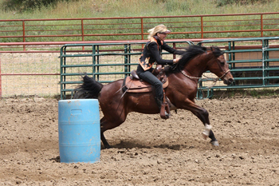
Notes:
Barrel racing

Slide 2
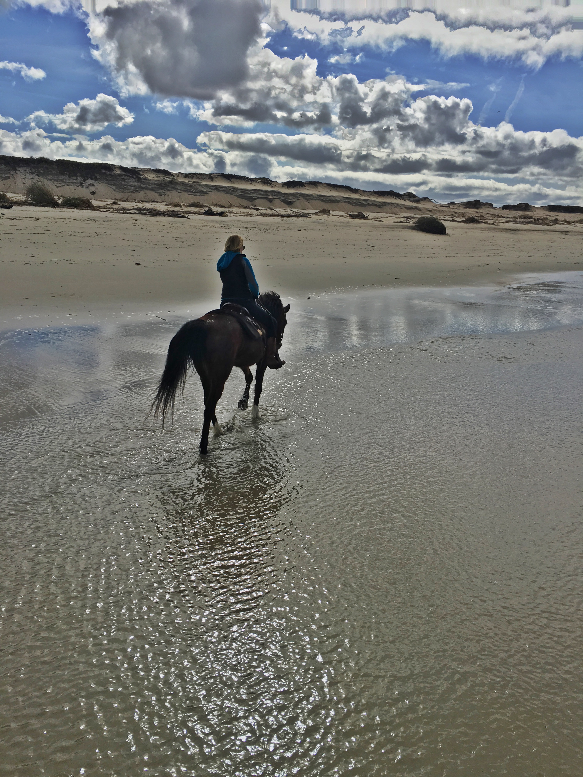
Notes:
Riding at the beach

Slide 3
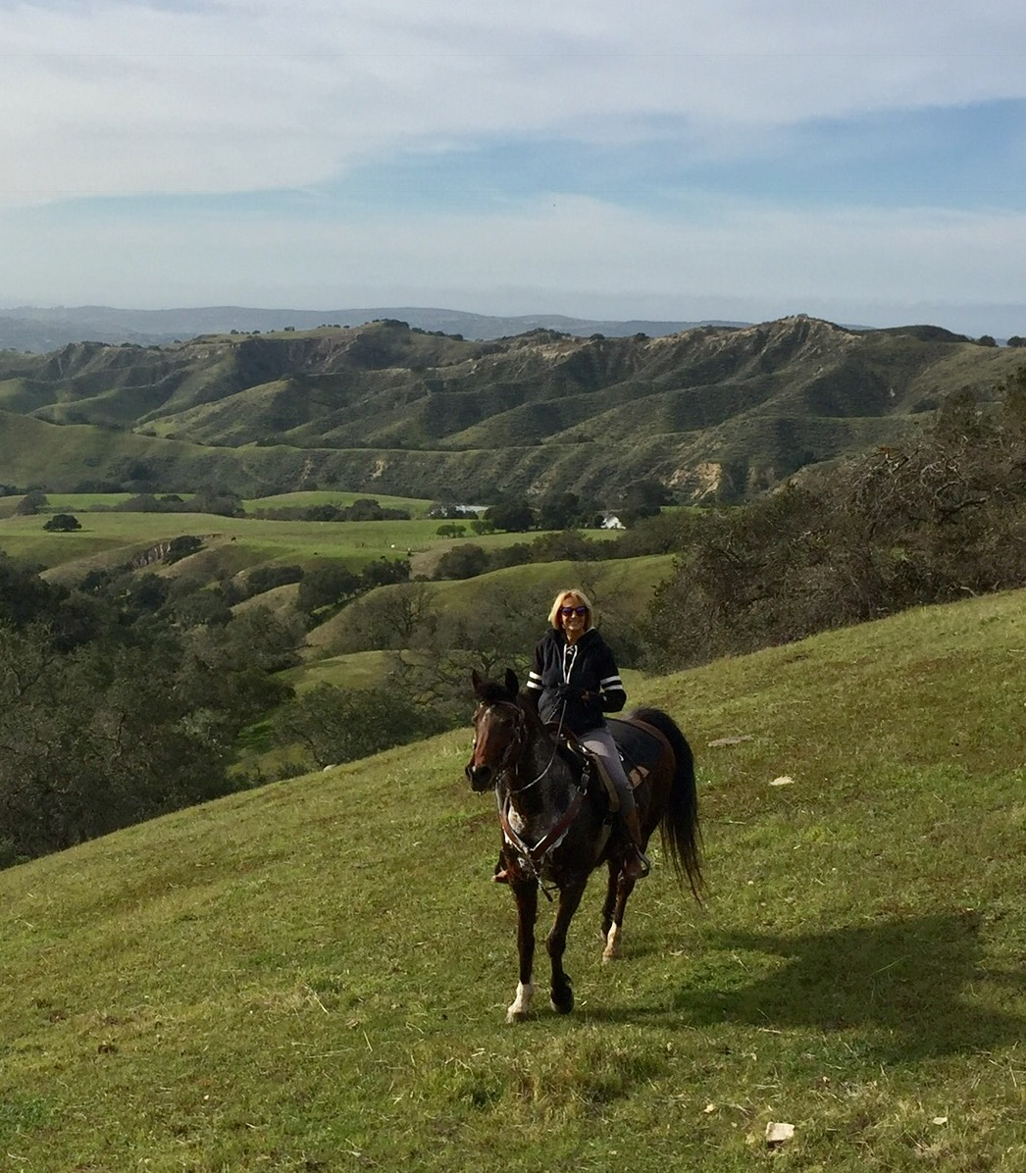
Notes:
Enjoying a spring day

Slide 4
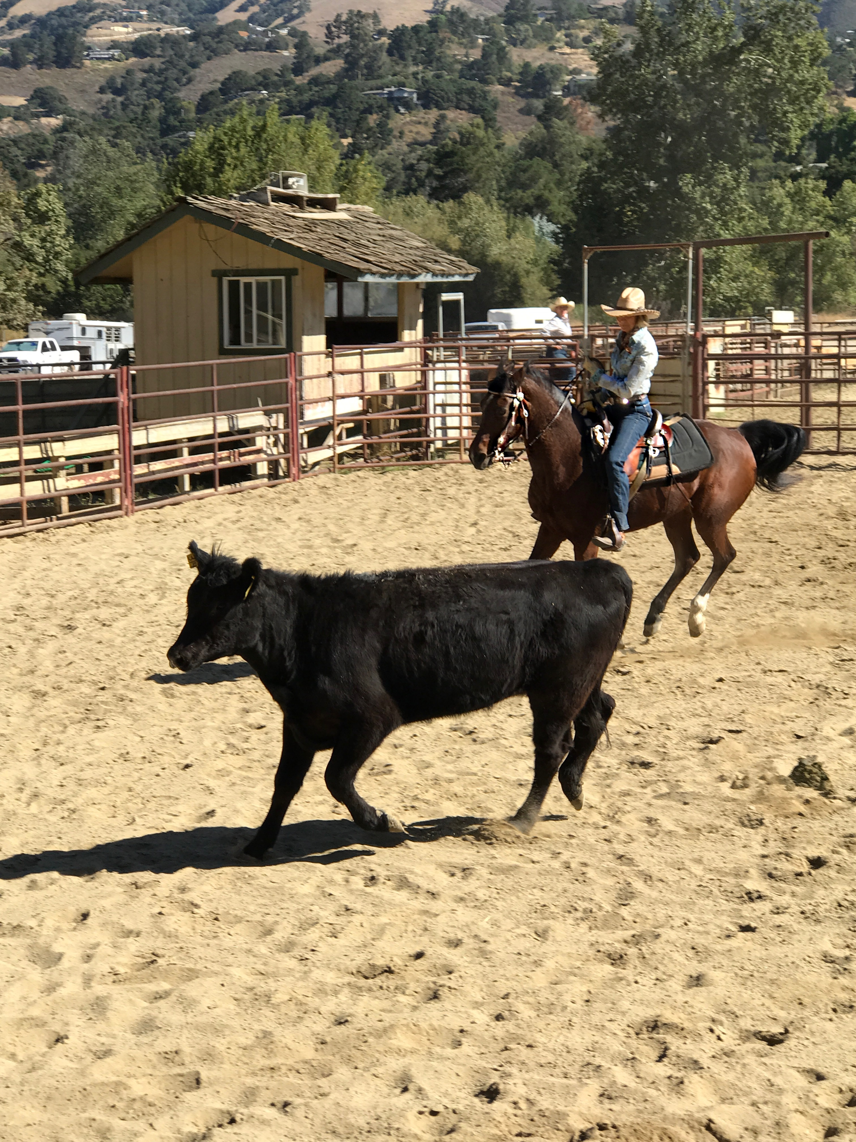
Notes:
Sorting cows in Carmel Valley

Slide 5
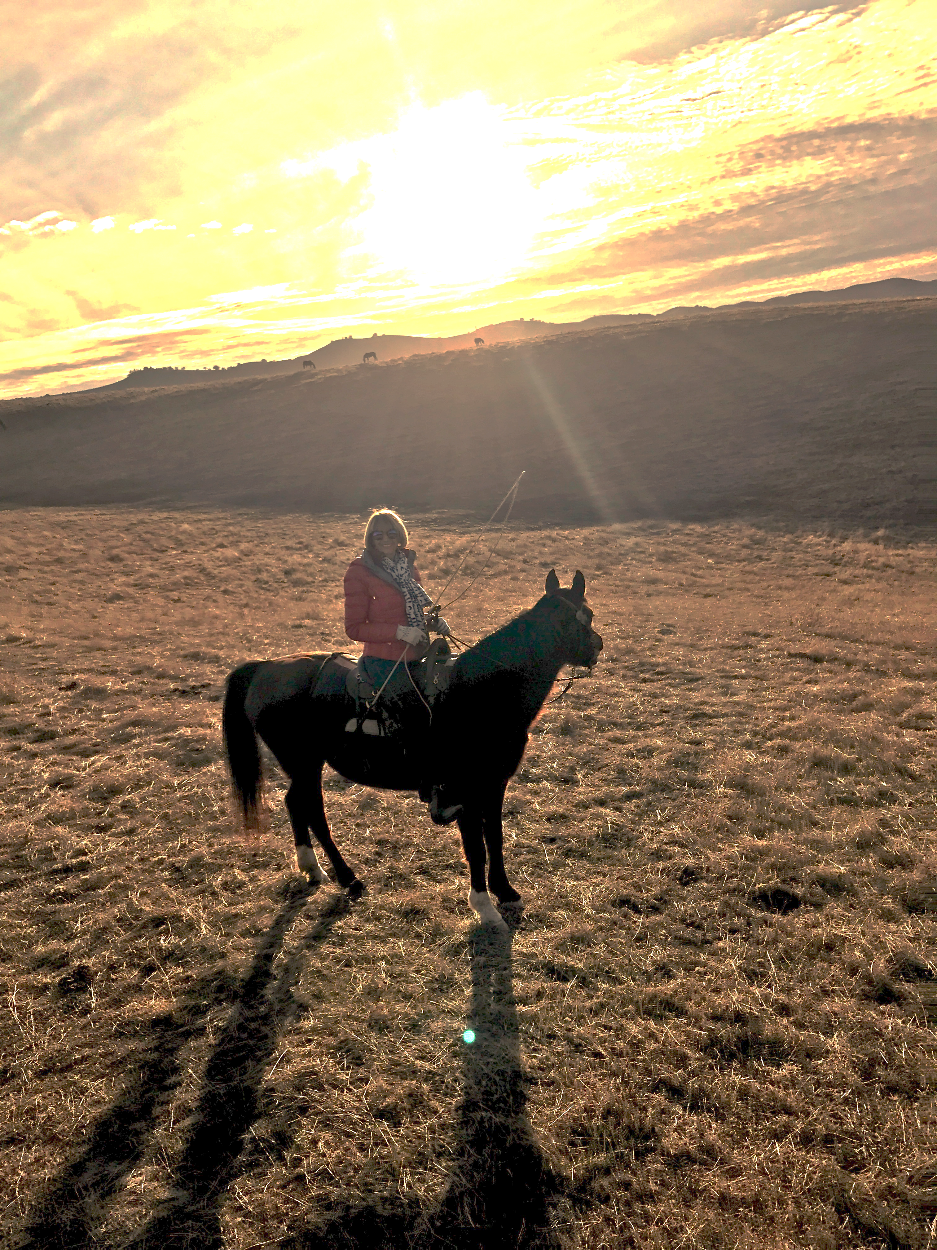
Notes:
Sunset on the home ranch.

Slide 6
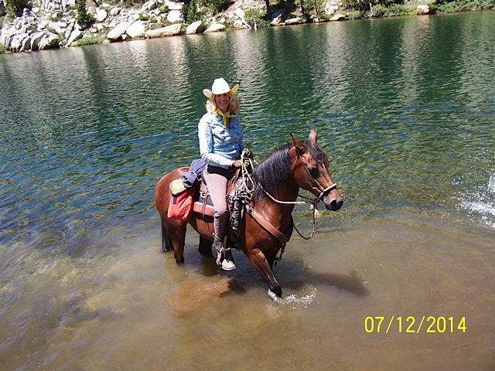
Notes:
Crossing a stream in Yosemite

Slide 7
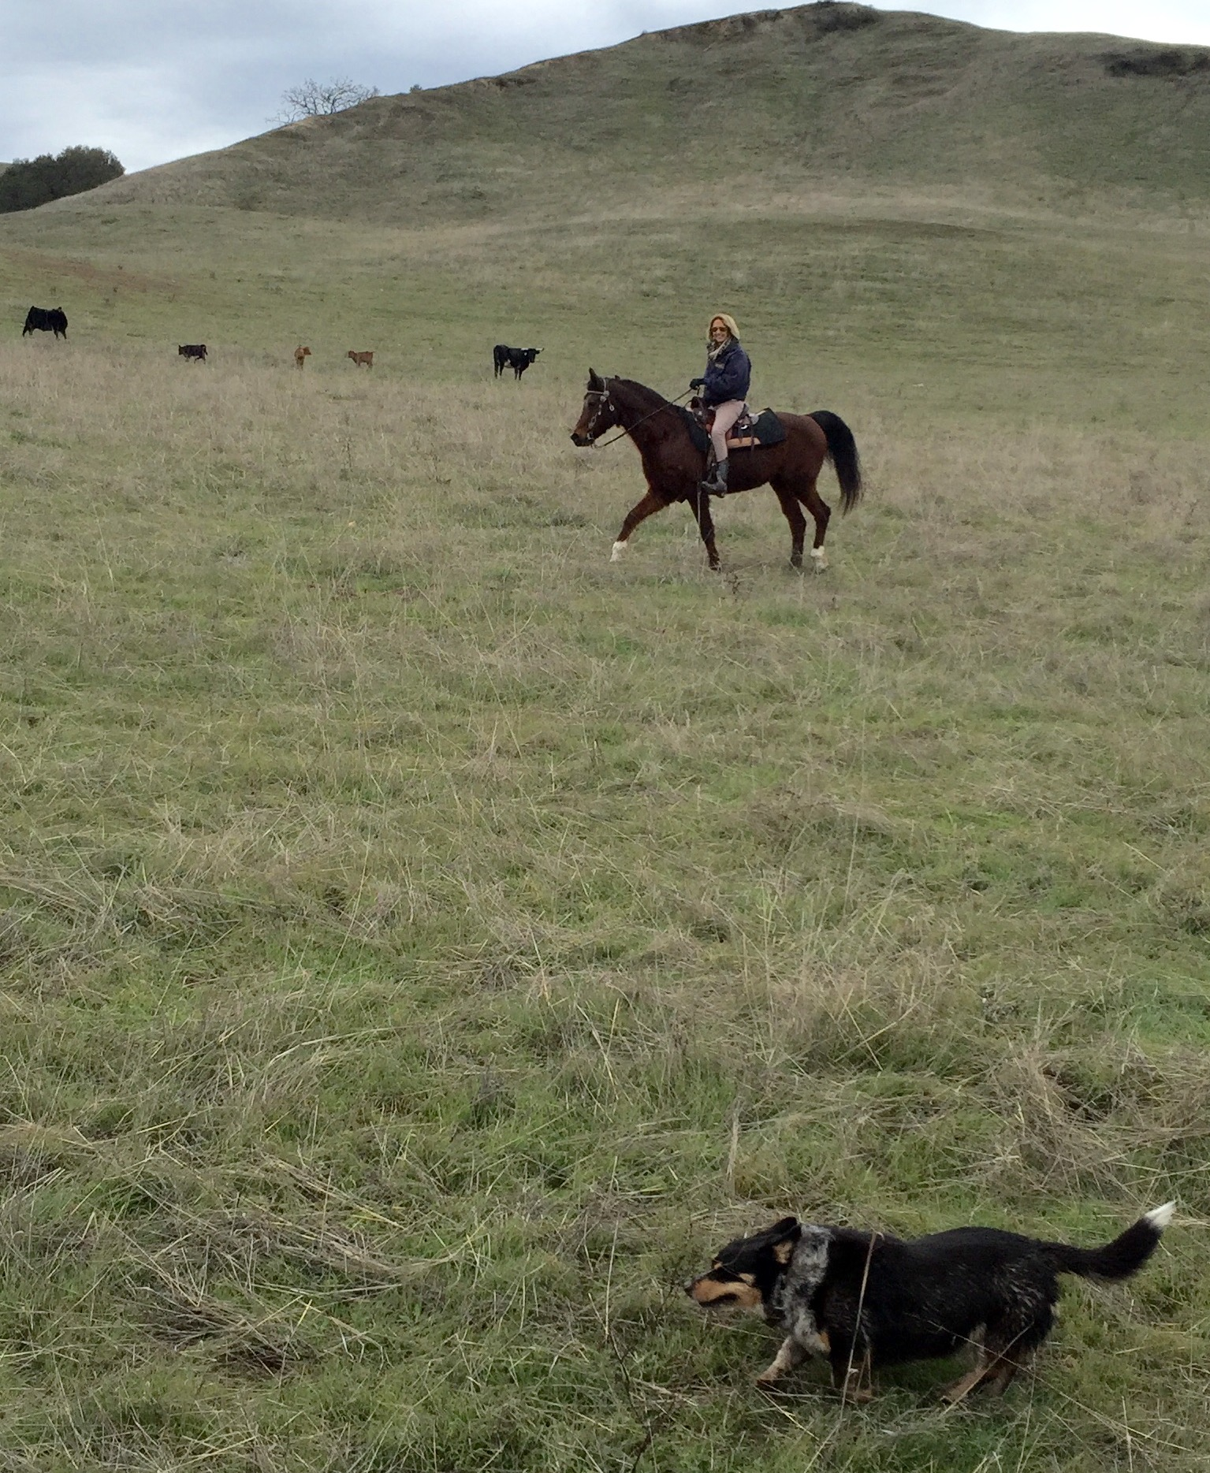
Notes:
Dog assisted gathering of cattle on the ranch

